Slide 1
Tobacco Prop Lending Library, Kane County Health Department
Division of Health Promotion

Slide 2
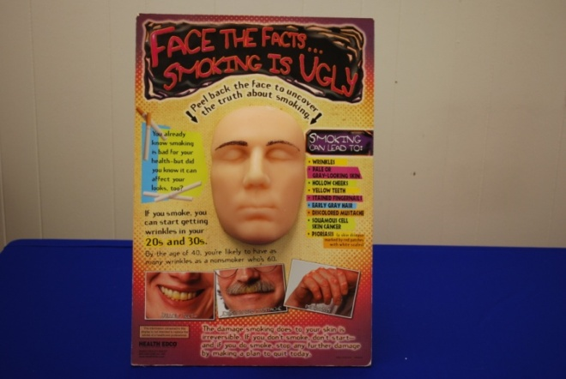
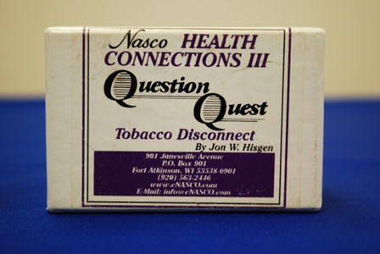
T1 T2
Face the Facts: Smoking Is Ugly (2):
Tobacco Question Quest Cards:
Display shows how smoking can affect your appearance. When the outer face model is peeled off, you discover the wrinkles, pale gray skin, hollow cheeks, and skin cancer that can be caused by smoking.
Question game on tobacco facts with cards

Slide 3
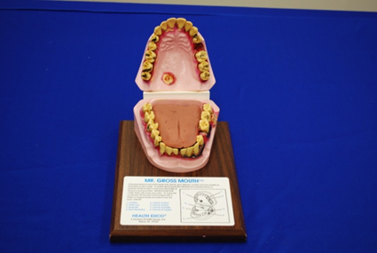
T3 T4
Giant Mr. Gross Mouth:
Mr. Gross Mouth (2):
Plastic replica of a smoker’s mouth, displaying receding gum and inflammation, tooth loss, cavities, cancer of tongue, cancer of the palate, etc.
Life-size replica of the teeth tongue and gums feature lifelike detail of the disgusting oral damage done by smokeless tobacco.

Slide 4
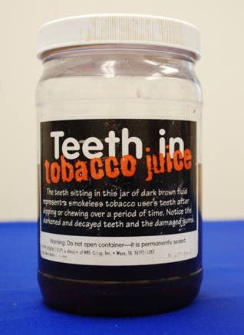
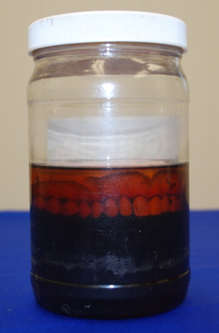
T5 T6
Teeth in Tobacco Juice:
Lou-Wheeze (2):
Prop with inflatable lungs, one healthy and the other riddled with cancer and emphysema (the two inflate differently, displaying the negative effects of smoking on lungs).
Fake teeth inside a tar-filled jar.

Slide 5
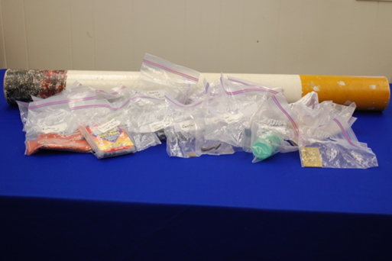
T7 T8
Big Cigarette & Ingredients (2):
Large cardboard cigarette containing some ingredients found in cigarettes.
Pack of Toxic Tar:
Cigarette models contain the combined total amount of tar a smoker inhales from just a single pack of cigarettes.

Slide 6
T9 T10
A Year’s Worth of Tar Jar (2):
Sealed jars containing the liquid tar that accumulates in the lungs as a consequence of smoking a pack of cigarettes for one year.
Lil’ Ciggies (2):
Stuffed toy cigarettes.

Slide 7
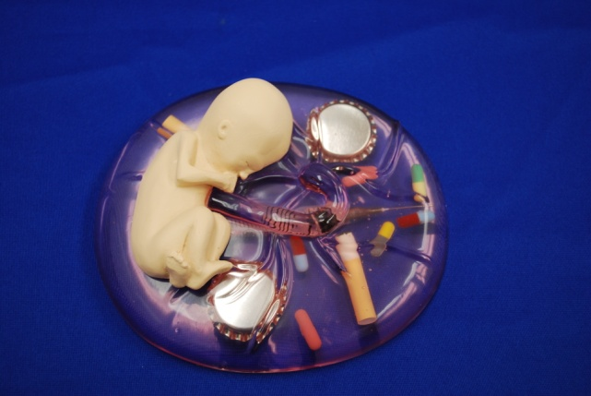
T11 T12
Cigarette in Baby Bottle (2):
Plastic baby bottle with two cigarettes in fake milk representing the mother’s inability to filter out cigarette ingredients for her baby while pregnant.
What Mommy Does…
Baby Does:
A display of cigarette butts, pills, and beer bottle caps suspended in plastic. This 3-D model illustrates how alcohol, tobacco, and other substances can cross the placenta and damage a fetus.

Slide 8
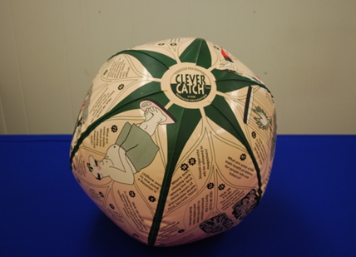
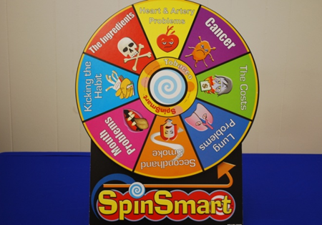
T13 T14
Spin Smart (2):
Clever Catch Beach Ball Tobacco Question Game (2):
Tobacco prevention clever catch provides a fun and engaging way to learn about the harmful effects of smoking.
An Educational game about tobacco side effects.

Slide 9
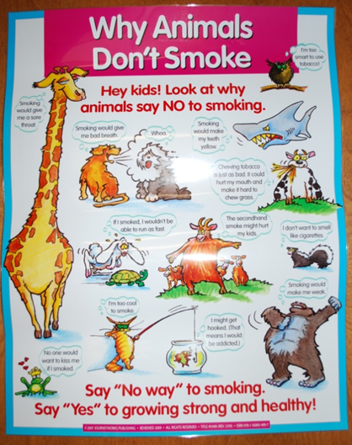
T15 T16
Puffing Poison Tank: A Secondhand Smoke Trap:
Why Animals Don’t Smoke Poster:
Can be used to raise awareness of the dangers of secondhand smoke.
Anti-tobacco message reminding kids that smoking is never a good idea.

Slide 10
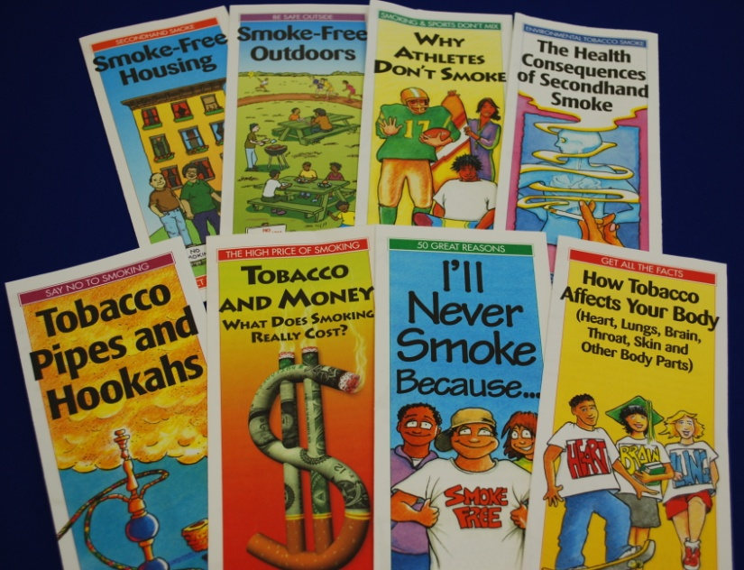
T17 T18
Tablecloths (6):
Assorted Tobacco & Smoking Brochures:
Kane County Health Department tablecloths can be used for events planned.
Several different brochures and literature is available for all target audiences

Slide 11
T19
Smoking Hurts Everyone Display Board:
Display board on the negative effects smoking has on the environment, young children and babies, and even on pets.

Slide 12
You can borrow the props in our tobacco lending library by contacting Terry roman
email: RomanTerry@co.kane.il.us
phone: (630) 264-7653

